Slide 1



VI SEMESTER
BIG DATA TECHNOLOGIES
Phase-1
on
PredictMe:
A Big Data & ML Platform for College Admission Prediction

Slide 2
Team Members
Alroy Deon Saldanha | Aniket RT | Amogh AP
1RV23AI012 | 1RV23AI017 | 1RV23AI013

Slide 3
Introduction
India's national and state-level entrance exams (JEE, NEET, KCET, COMEDK) each publish cutoff and closing-rank data every admission cycle, spread across inconsistent government PDFs, spreadsheets, and portals.
1
Ingest & Unify
2
Predict Probability
PredictMe ingests, cleans, and unifies counselling data at scale using Apache Spark.
Domain-specific ML models estimate admission probability for a given rank, category, and quota.
3
Serve in Real Time
4
Four Exam Domains
A FastAPI backend with Redis caching returns predictions in sub-10ms, shown on a React frontend.
One unified platform spans JEE, NEET UG / PG, KCET, and COMEDK — data engineering meets real-time serving.

Slide 4
Identification of Problem
Every year, lakhs of JEE, NEET, KCET and COMEDK candidates receive a rank or percentile but have no reliable way to know which colleges and courses they can realistically get into.
1
Fragmented, Messy Data
2
Scale Beyond Machines
3
High-Dimensional Space
Counselling / cutoff data published as inconsistent CSVs, wide-header Excel sheets, and scanned tables.
Years of allotment records across four exams are too large for spreadsheets or single-threaded scripts.
Closing ranks vary across {Institute, Course, Category, Quota, Round} — poor fit for relational lookups.
4
No Sense of Probability
5
No Unified Real-Time Tool
Naive nearest-rank lookups give only a rigid pass / fail answer, not a likelihood of admission.
Existing predictors are single-exam, non-scalable, and can't serve lakhs of concurrent users.

Slide 5
Literature Review
# | Paper | Year | Concept Defined | Research Gap
1 | Admission Prediction in Undergraduate Applications: An Interpretable Deep Learning Approach | 2024 | Uses an interpretable, attention-based deep learning model over applicant profiles to predict undergraduate admission decisions. | Built for a single institution's holistic review data; no support for multi-exam, rank-based public counselling systems or distributed processing.
2 | Quantifying Holistic Review: A Multi-Modal Approach to College Admissions Prediction | 2025 | Decomposes admission evaluation into human-aligned sub-components using multi-modal (text + numeric) features for transparent modeling. | Targets essay-driven US admissions; does not address rank/category/quota-based counselling used in Indian entrance exams (JEE/NEET/KCET).
3 | LLM-Augmented and Fair Machine Learning Framework for University Admission Prediction | 2025 | Combines structured academic/demographic data with LLM-derived text signals and fairness constraints for admission prediction. | Heavy LLM inference cost makes it unsuitable for low-latency, high-throughput prediction serving at scale.
4 | Machine Learning Based Prediction Model for College Admission | 2023 | Applies classical ML (Decision Tree, Random Forest, SVM) on historical cutoff/rank data to predict admission chances. | Single-domain, small-scale dataset processed on one machine; no distributed ingestion or category/quota-aware probabilistic modeling.
5 | A Big Data Analysis Framework Using Apache Spark and Deep Learning | 2018 | Combines Spark's distributed computation with a deep MLP model via cascade learning for scalable big-data analytics. | General-purpose framework not tailored to tabular rank/category prediction; no caching layer for repeated low-latency queries.

Slide 6
Literature Review
# | Paper | Year | Concept Defined | Research Gap
6 | Applying Machine Learning on Big Data With Apache Spark | 2025 | Benchmarks ML models (Linear/RF/GBT/SVR/KNN) within Spark MLlib across large regression and classification datasets. | Evaluated on generic datasets (taxi trips, Netflix, Higgs); does not explore ETL for messy, multi-format admission/counselling data.
7 | Benchmarking State-of-the-Art Gradient Boosting Algorithms for Classification | 2023 | Systematically compares GBM, XGBoost, LightGBM, and CatBoost on accuracy, runtime, and tuning cost with Bayesian optimization. | Purely a benchmarking study on generic datasets; findings not applied to a live, category-aware admission probability system.
8 | CatBoost: Gradient Boosting with Categorical Features Support | 2018 | Introduces CatBoost's ordered boosting and native categorical handling, outperforming tuned XGBoost with default parameters. | Focused on the algorithm itself; no discussion of deployment, real-time serving, or integration with a distributed data pipeline.
9 | Declarative Data Pipeline for Large Scale ML Services | 2025 | Proposes a modular “Pipes” framework that declaratively integrates ML capability inside Spark for large-scale ML services. | Emphasizes pipeline declarativity over user-facing low-latency serving or caching of repeated prediction queries.
10 | Accelerating Deep Learning Inference via Learned Caches | 2021 | Proposes learned/neural caches to reduce DNN inference latency in prediction serving systems. | Targets deep-learning inference caching; does not address simple, high-throughput key-based caching (e.g. Redis) for tree-based tabular models.

Slide 7
Literature Survey
Summary of Literature Survey
A clear shift from rigid cutoff lookups to ML-driven probability estimation (deep learning, gradient boosting) for admission and eligibility prediction.
Gradient boosting libraries (XGBoost, LightGBM, CatBoost) consistently outperform generic baselines on tabular, categorical-heavy data — motivating our use of CatBoost/XGBoost.
Apache Spark is widely used to scale ML pipelines, but most published pipelines target generic or single-domain datasets, not messy multi-format government counselling data.
Caching/serving research (learned caches, Redis-backed inference) shows large latency wins for repeated queries — a pattern well suited to admission prediction.
Most existing admission-prediction work is single-institution, single-exam, or purely academic, with no deployed real-time serving layer.
Our proposed system, PredictMe, unifies all of these: Spark-based distributed ETL across 4 exam domains, CatBoost/XGBoost probability modeling, Redis-cached FastAPI serving, and a real-time interactive frontend.

Slide 8
Problem Definition
Given a student's rank/percentile, category, quota, and exam domain (JEE / NEET / KCET / COMEDK), compute the probability of admission into every (Institute, Course) pair using historical closing-rank distributions.
1
Formal Pipeline
2
Scale Constraint
Raw Counselling Data → Spark ETL → Feature Store → {Classifier / Regressors} → probability-ranked results.
Process millions of historical records across 4 exam domains despite messy, inconsistent source formats.
3
Latency Constraint
4
Interface Constraint
Repeated queries for the same {rank, category} must be served well under 10ms via caching.
Results exposed through a responsive web UI usable by lakhs of concurrent students in season.

Slide 9
Objectives
1
Distributed Data Pipeline
2
Predictive Feature Engineering
3
Domain-Specific ML Models
Ingest, clean, and partition multi-year, multi-format counselling datasets using Apache Spark.
Aggregate {Institute, Course, Category, Quota} into closing-rank distributions stored as Parquet.
CatBoost / XGBoost classifiers (JEE) and regressors (NEET / KCET / COMEDK), tuned with Optuna.
4
Real-Time Serving
5
Interactive Frontend
A unified FastAPI backend with Redis caching returns repeated queries in milliseconds.
A responsive React interface showing ranked “Safe” and “Likely” college-course options.

Slide 10
Methodology
1. Ingest & Partition
2. Clean & Unify Schema
3. Feature Engineer
4. Train Models
5. Serve & Present
Raw JEE / NEET / KCET / COMEDK datasets ingested & partitioned via Apache Spark.
Drop nulls, parse inconsistent headers, write unified Parquet storage.
Aggregate by {Institute, Course, Category, Quota} into rank thresholds.
CatBoost / XGBoost classifier (JEE) + regressors (others), tuned via Optuna.
FastAPI + Redis cache results; React / Vite renders ranked Safe / Likely picks.

Slide 11
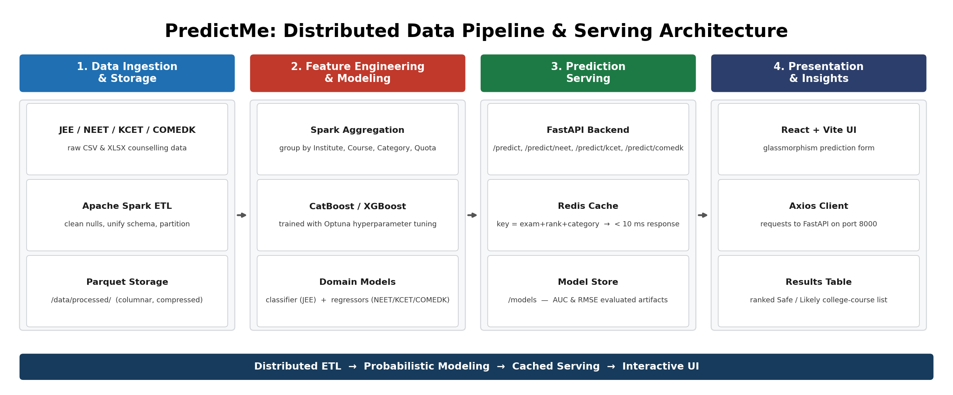
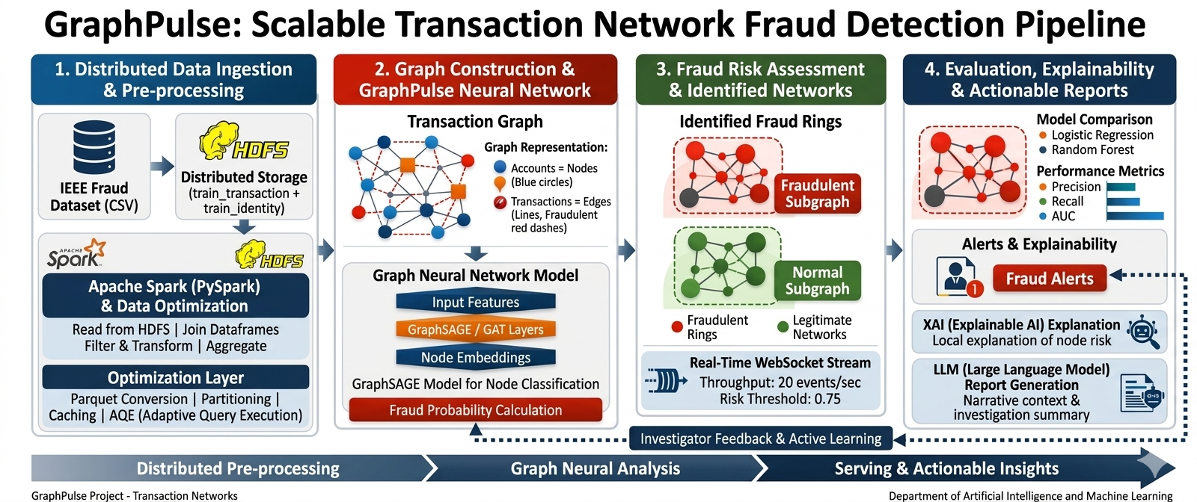
System Architecture

Slide 12
Proposed Tools and Techniques
1. Data Infrastructure
2. Machine Learning Stack
3. Serving & Backend
• Apache Spark (PySpark) – distributed ETL across all exam domains
• Parquet – columnar storage, /data/processed/
• Docker – Spark + HDFS cluster for local dev
• CatBoost – categorical-native classifiers / regressors
• XGBoost – gradient-boosted benchmarking models
• Optuna – automated hyperparameter tuning
• FastAPI – unified REST microservice, 4 domain routes
• Redis – sub-10ms cache for repeated queries
4. Frontend
5. Data Sources
• React + Vite – glassmorphism prediction UI
• Axios – API calls to FastAPI on port 8000
• Official Counselling Data – historical JEE, NEET, KCET, COMEDK records

Slide 13
Expected Outcome
1
Unified Web Platform
2
Probability Tiers
3
Fast Distributed Pipelines
Enter rank, category, and quota for JEE / NEET / KCET / COMEDK and get a ranked list of eligible options.
“Safe” / “Likely” probability tiers replace a rigid pass / fail cutoff.
Spark processes multi-year, multi-format datasets end-to-end in minutes, not hours.
4
Sub-10ms Responses
5
Extensible Architecture
Redis caching supports high concurrency during peak counselling season.
New exams or rounds onboard via a new ingestion script and model — no serving / UI changes.

Slide 14
Conclusion
1
Big Data Meets ML
2
Probabilistic, Not Rigid
Apache Spark, HDFS, and Parquet combine with CatBoost / XGBoost to turn fragmented data into a fast prediction service.
Category / quota-aware predictions give students a realistic, data-driven view of admission chances.
3
Real-Time Product
4
Future Work
The Redis-cached FastAPI layer and React frontend show Big Data delivered as a responsive product.
Cover more state-level exams, live counselling-round updates, and explainability for “Safe”/“Likely” calls.

Slide 15
Thank You

